Slide 1
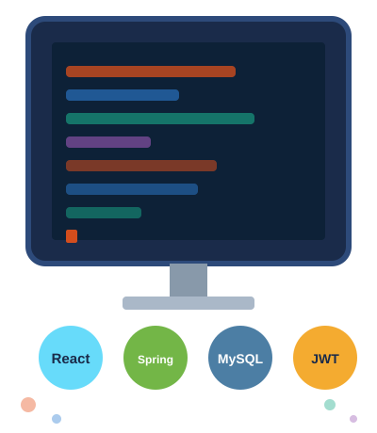
PlanIt
Event Management System
with Task Assignment
React
Spring Boot
MySQL
JWT
Team of 8 · Full Stack Microservice Project
B. Tharun · N. Shahanadh · B. Munendra · L. Rama Kasturi
K. Mythili · Peetla Lalitha · M. Veera Prathap · H.B Purushottam
PlanIt · Event Management System
React · Spring Boot · MySQL · JWT

Slide 2
Team Assignments at a Glance
Member
Microservice / Service
Scope
FR
K. Mythili
User & Authentication Service
Backend + FE
FR-05
H.B Purushottam
Staff Entity & Inheritance Service
Backend
FR-02,05
N. Shahanadh
Event Management Service
Backend
FR-01
L. Rama Kasturi
Task Management Service
Backend
FR-02
B. Tharun
Task Assignment + Planner Dashboard
Backend + FE
FR-02
B. Munendra
Staff Operations Service
Backend
FR-03
Peetla Lalitha
Client Portal + Staff Dashboard FE
Backend + FE
FR-03,04
M. Veera Prathap
Client Portal Frontend
Backend + FE
FR-03,04
PlanIt · Event Management System
React · Spring Boot · MySQL · JWT

Slide 3

Why This Project?
The problems PlanIt was built to solve
01
Manual Event Chaos
Spreadsheets, sticky notes — no single system to track events.
02
Tasks Get Lost
Staff don't know assignments or deadlines. Duplication everywhere.
03
No Client Visibility
Clients can't track progress. Feedback collected informally.
04
Zero Access Control
Anyone can see or edit anything — no roles, no permissions.
PlanIt · Event Management System
React · Spring Boot · MySQL · JWT

Slide 4
Technologies Used
The full stack powering PlanIt
01
React.js — Frontend
SPA · Component-based UI · Axios REST calls · Role-based routing
02
Spring Boot — Backend
Java REST API · Spring Security · JWT filter · @RestController
03
MySQL — Database
User, Staff, Event, Task tables · FK constraints · JPA/Hibernate
04
JWT + JPA Inheritance
Token auth · Role guards · Staff IS-A User (SINGLE_TABLE)
PlanIt · Event Management System
React · Spring Boot · MySQL · JWT

Slide 5
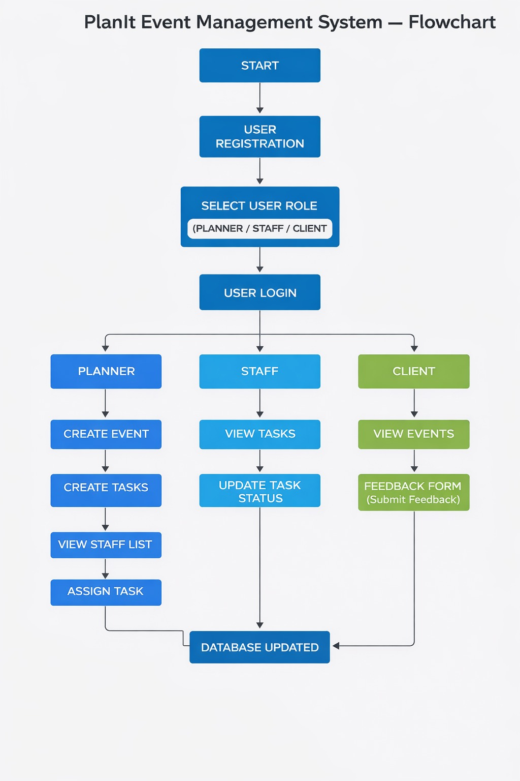
System Flowchart
How every user role interacts with PlanIt — from registration to database update

Slide 6
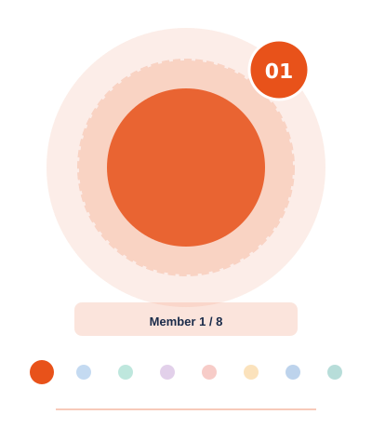
User & Authentication Service
"The security gatekeeper — every login, every token, every role guard."
Mythili built PlanIt's security backbone. She designed the User entity, created registration and login endpoints, and configured Spring Security so every protected route validates a JWT before responding.
DELIVERABLES
01
entity/User.java
Fields: id, username, password, email, role (PLANNER/STAFF/CLIENT)
02
POST /api/user/register
Registers any user type with BCrypt-hashed password storage
K. Mythili
03
POST /api/user/login
Validates credentials and issues a signed JWT session token
Backend + Frontend
04
Spring Security Filter Chain
FR: FR-05
Validates JWT on every incoming API request before routing
05
Role Access Guards
/api/planner/*, /api/staff/*, /api/client/* locked to correct roles
PlanIt · Event Management System
React · Spring Boot · MySQL · JWT

Slide 7
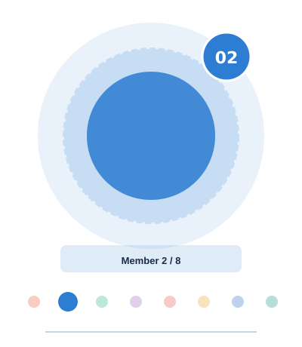
Staff Entity & Inheritance Service
"The OOP architect — Staff IS-A User via JPA Inheritance."
Purushottam implemented the IS-A relationship between Staff and User using JPA's SINGLE_TABLE strategy. Staff inherits all user fields while adding staff-specific behavior and repository queries.
DELIVERABLES
01
entity/Staff.java
Extends User — inherits id, username, password, email, role
02
@Inheritance(SINGLE_TABLE)
@DiscriminatorValue('STAFF') — both types in one DB table
H.B Purushottam
03
Custom Repository
findByRole() and findAllStaff() for efficient staff queries
Backend
04
GET /api/planner/staff
FR: FR-02, FR-05
Returns all staff members so planners can assign tasks
05
OOP Key Outcome
Staff IS-A User demonstrated at JPA and database level
PlanIt · Event Management System
React · Spring Boot · MySQL · JWT

Slide 8
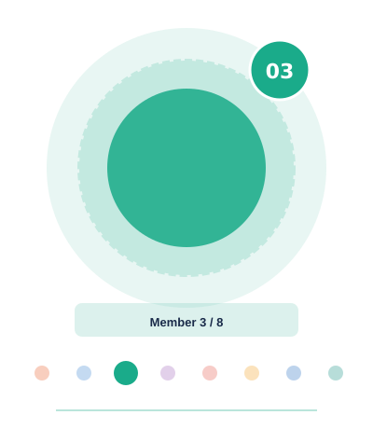
Event Management Service
"The event engine — create, update, and query every event."
Shahanadh owns the core of what PlanIt does. He designed the Event entity with title, date, location, status and feedback fields, wrote EventService with four operations, and exposed REST endpoints for planners.
DELIVERABLES
01
entity/Event.java
id, title, date, location, description, status, feedback
02
service/EventService.java
createEvent(), updateEvent(), getEventsByPlanner(), getAllEvents()
N. Shahanadh
03
POST /api/planner/event
Planner creates a new event linked to their account
Backend
04
PUT /api/planner/event/{id}
FR: FR-01
Planner edits title, date, location, or status
05
GET /api/planner/events
Returns all events for the planner's dashboard view
PlanIt · Event Management System
React · Spring Boot · MySQL · JWT

Slide 9
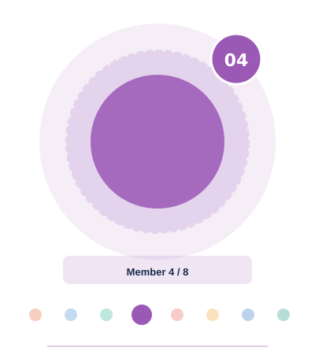
Task Management Service
"The task backbone — the entity, FK, and service layer."
Rama Kasturi built the Task entity and the FK link to the Staff table — the most critical data relationship in PlanIt. She wrote TaskRepository custom queries and TaskService methods.
DELIVERABLES
01
entity/Task.java
id, description, status, Staff assignedStaff (FK → Staff table)
02
TaskRepository.java
findByAssignedStaff() and findByStatus() custom query methods
L. Rama Kasturi
03
service/TaskService.java
createTask(), getAllTasks(), updateTaskStatus() operations
Backend
04
POST /api/planner/task
FR: FR-02
Planner creates an unassigned task — ready for assignment
05
GET /api/planner/tasks
Returns all tasks so planners can decide who to assign each to
PlanIt · Event Management System
React · Spring Boot · MySQL · JWT

Slide 10
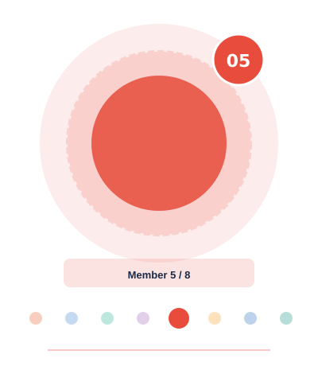
Task Assignment + Planner Dashboard
"The connector — linking tasks to people, building the dashboard."
Tharun built the task assignment endpoint and the complete planner frontend. He wrote assignTask() with ID validation to prevent corrupt assignments and built four React pages for the full planner workflow.
DELIVERABLES
01
POST /tasks/{taskId}/assign/{staffId}
Links a task to a specific staff member via path variables
02
assignTask() in TaskService
Validates both IDs exist in DB before persisting the link
B. Tharun
03
DB Persistence
Task.assignedStaff is updated and saved on successful assignment
Backend + Frontend
04
AssignTaskPage.jsx
FR: FR-02
Planner selects task + staff from dropdowns and clicks Assign
05
Full Planner Dashboard
CreateEventForm, UpdateEventForm, CreateTaskForm — full UI
PlanIt · Event Management System
React · Spring Boot · MySQL · JWT

Slide 11
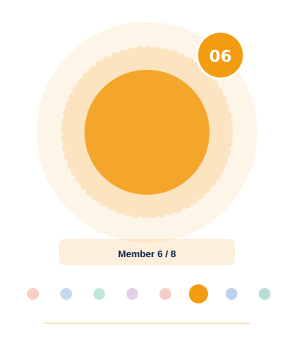
Staff Operations Service
"The staff gateway — every task view and update flows through here."
Munendra wrote the StaffController with strict role separation. Only STAFF tokens can access these endpoints. He implemented the task status update flow that delegates cleanly to the shared TaskService.
DELIVERABLES
01
StaffController.java
All staff-facing API endpoints in one dedicated controller
02
GET /api/staff/tasks/{staffId}
Staff retrieves only their own tasks — no visibility of others
B. Munendra
03
PUT /api/staff/tasks/{taskId}
Staff updates task status via ?status= query parameter
Backend
04
Service Delegation
FR: FR-03
updateTaskStatus() delegates to TaskService — no duplicate logic
05
Role Guard
Only STAFF JWT tokens are permitted to access these endpoints
PlanIt · Event Management System
React · Spring Boot · MySQL · JWT

Slide 12
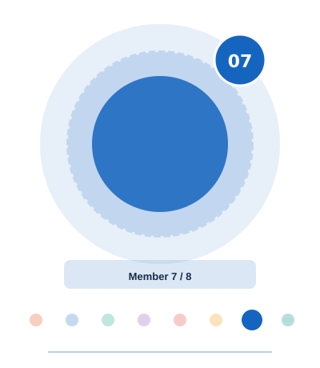
Client Portal Backend + Staff Dashboard FE
"The bridge — client APIs + the staff dashboard interface."
Lalitha built the ClientController APIs and implemented submitFeedback() that saves client text onto Event records. She also built both staff-facing React pages for task viewing and status updates.
DELIVERABLES
01
ClientController.java
All client-facing API endpoints in one isolated controller
02
GET /api/client/events
Clients browse all events and see their current statuses
Peetla Lalitha
03
PUT /api/client/event/{id}
Client submits feedback text via ?feedback= query param
Backend + Frontend
04
StaffTasksPage.jsx
FR: FR-03, FR-04
Staff sees their full task list with current status badges
05
UpdateTaskStatusPage.jsx
Staff selects a new status from dropdown and submits update
PlanIt · Event Management System
React · Spring Boot · MySQL · JWT

Slide 13
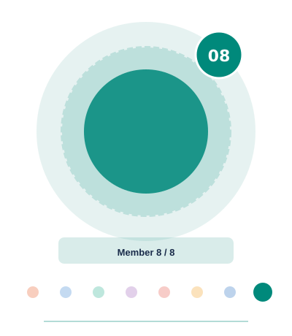
Client Portal Frontend
"The client's window — browse events and submit feedback."
Veera Prathap built the complete client-facing frontend with live event status display, a dynamic feedback form, JWT-aware Axios calls, and route guards so only CLIENT role users can access these pages.
DELIVERABLES
01
ClientEventsPage.jsx
Displays all events with title, date, location and live status
02
FeedbackForm.jsx
Dynamic event dropdown + text field — submits to feedback API
M. Veera Prathap
03
HttpService.js
Axios wrapper auto-attaches JWT token to every outgoing call
Backend + Frontend
04
Protected Route
FR: FR-03, FR-04
CLIENT role check on every navigation — redirects others to login
05
Route Guard
Prevents staff or planners from accessing the client portal
PlanIt · Event Management System
React · Spring Boot · MySQL · JWT

Slide 14
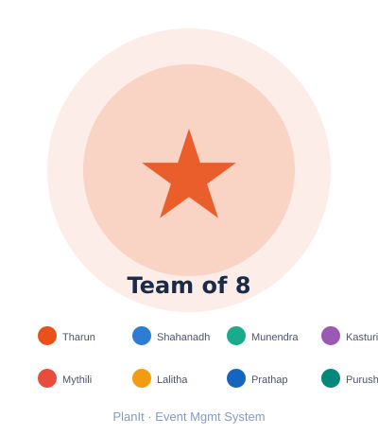
Thank
You!
PlanIt — Event Management System
React · Spring Boot · MySQL · JWT · JPA · REST API
A Full Stack Microservice Project
B. Tharun
N. Shahanadh
B. Munendra
L. Rama Kasturi
K. Mythili
Peetla Lalitha
M. Veera Prathap
H.B Purushottam
PlanIt · Event Management System
React · Spring Boot · MySQL · JWT

